Slide 1


Web Scraping

Slide 2
Topics
What is Web Scraping
Use Case of Web Scraping
Web Scraping process flow
Web Scraping in Python
Requests
Beautiful Soup

Slide 3
What is Web Scraping
Web Scraping is the process of extracting Data from the website
The contribution of an agent to download, parse the organise Data from the web in an automated manner is Web Scraping
Web Scraping is also known as Web Harvesting, Web Data Extraction or even Web Data Mining

Slide 4
Use Case of Web Scraping
Google Translate utilises text stored on the web to train and improve itself
hiQ sells employee data analyses by collecting and examining public profile information
Images scraped from the Tinder and Instagram were used to predict weather images will be popular or not
Lyst scraped the web for information about fashion products to present a clean and elegant website
Emmanuel sales also scraped Twitter to make sense of his own social circle and timelines of posts

Slide 5
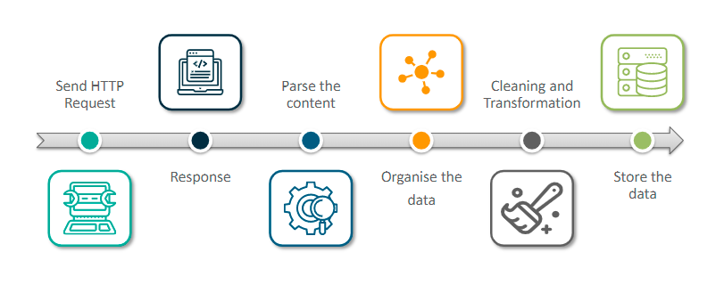
Web Scraping Process Flow

Slide 6
Web Scraping Process Flow
Send HTTP Request – an HTTP request is sent to the URL of the webpage (URL)
Response – The server responds with HTML contents of the webpage
Parse the content – Collect the required data from the response content
Organize the data – organize the data into structured format
Cleaning & Transformation – Eliminate unnecessary, repetitive, or missing data
Store the data – Storing data in the respective formats like CSV, JSON, XML.

Slide 7
Popular Tools for Web Scraping in Python
Requests
This is the python library that is widely used for sending and receiving info over HTTP
Can be installed by pip
With requests we can fetch the HTML content of webpage to create Beautiful Soup object
Beautiful Soup
Python library to extract the data from HTML and XML files
It can work with malformed HTML documents
It creates a parse tree from parsed HTML documents to extract data
Beautiful Soup cannot fetch pages on its own, it needs external library like requests

Slide 8
Beautiful Soup Filtering Content
find – it will retrieve the first result
find_all – it will return a list of all the matched tag to the string
Using_list – it will return a list of tags for filtering the content
attrs – the parameter takes a dictionary with attributes as keys and their values

